Slide 1

Network Optimization of Supply Chain Operation for
Fast Moving Consumer Goods
Presented by
Md. Mizanur Rahman Chowdhury
Student ID: 2003126
Supervisor
Md. Aminul Islam
Associate Professor
Department of Mechanical Engineering
Chittagong University of Engineering & Technology

Slide 2
Introduction
Supply Chain Management
Supplier
Manufacturer
Distributer
Retailer
Consumer
Planning
Using Existence Software
Production Operation
Measuring
Performance
And Prediction Outcome
Sourcing
Operation
Personal Data Driven Decision
My focused Point
Target Expected Final Product

Slide 3
Objectives
To simulate supply chain networks
To minimize the cost
To do futuristic analysis
To develop supply chain strategy

Slide 4
Research Methodology
Historical FMCG SCN
Selected FMCG SCN
Optimized FMCG SCN
DES
MILP
Demand Prediction
ML
Mathematical Model
Data
Making Decision

Slide 5
Data description analysis
N1
N2
N2
N1
N3
N3
Plant
Storage
N4
N4
N..
N..
N(n-1)
N(n)
N(n)
N(n-1)
Plant and storage of one product as node
Nodes amount around 42
Amount of date 221
Total networks executing 42*221
Each day attempting a network of each node

Slide 6
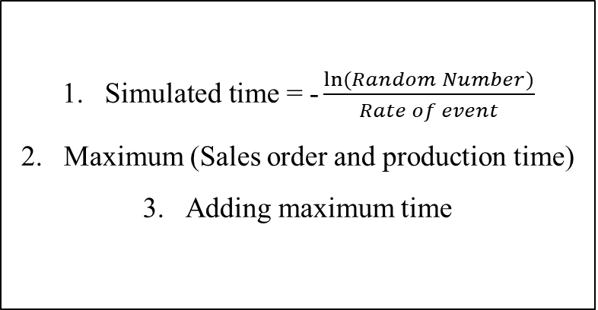
Discrete Event Simulation
Supply Chain Criteria: Conditional Strategies
Inverse Transform method for Exponential Interval times: A probabilistic time simulator
(Max, +) algebra: Maximum time identifier
Mid Sales Order
Higher Production
Less stock
Allow only less 100 units deficit
Pursue Random number
$\text{Simulated} \text{time}\text{ =}\text{ −}\frac{ln⁡(Random Number)}{Rate of event}$
Maximum (Sales order and production time)
Adding maximum time

Slide 7
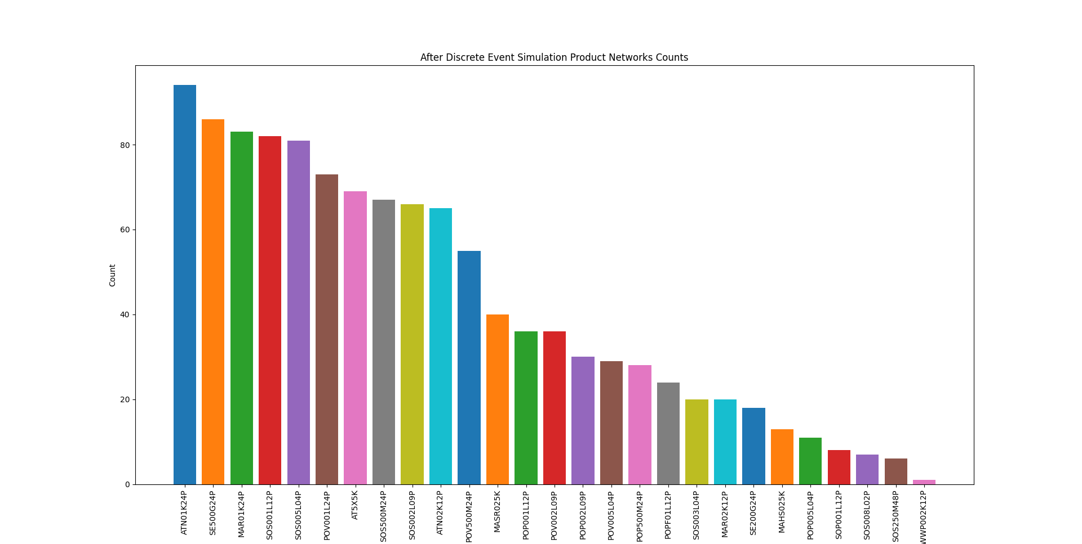
Discrete Event Simulation: Findings
Selected networks 1148
27 Product networks

Slide 8
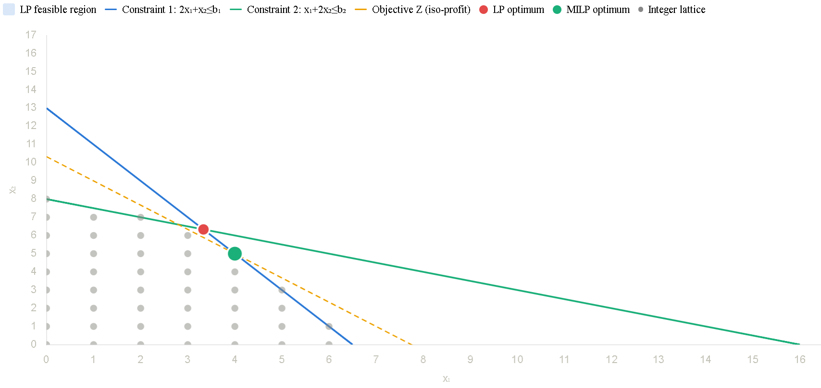
Mixed integer linear programming

Slide 9
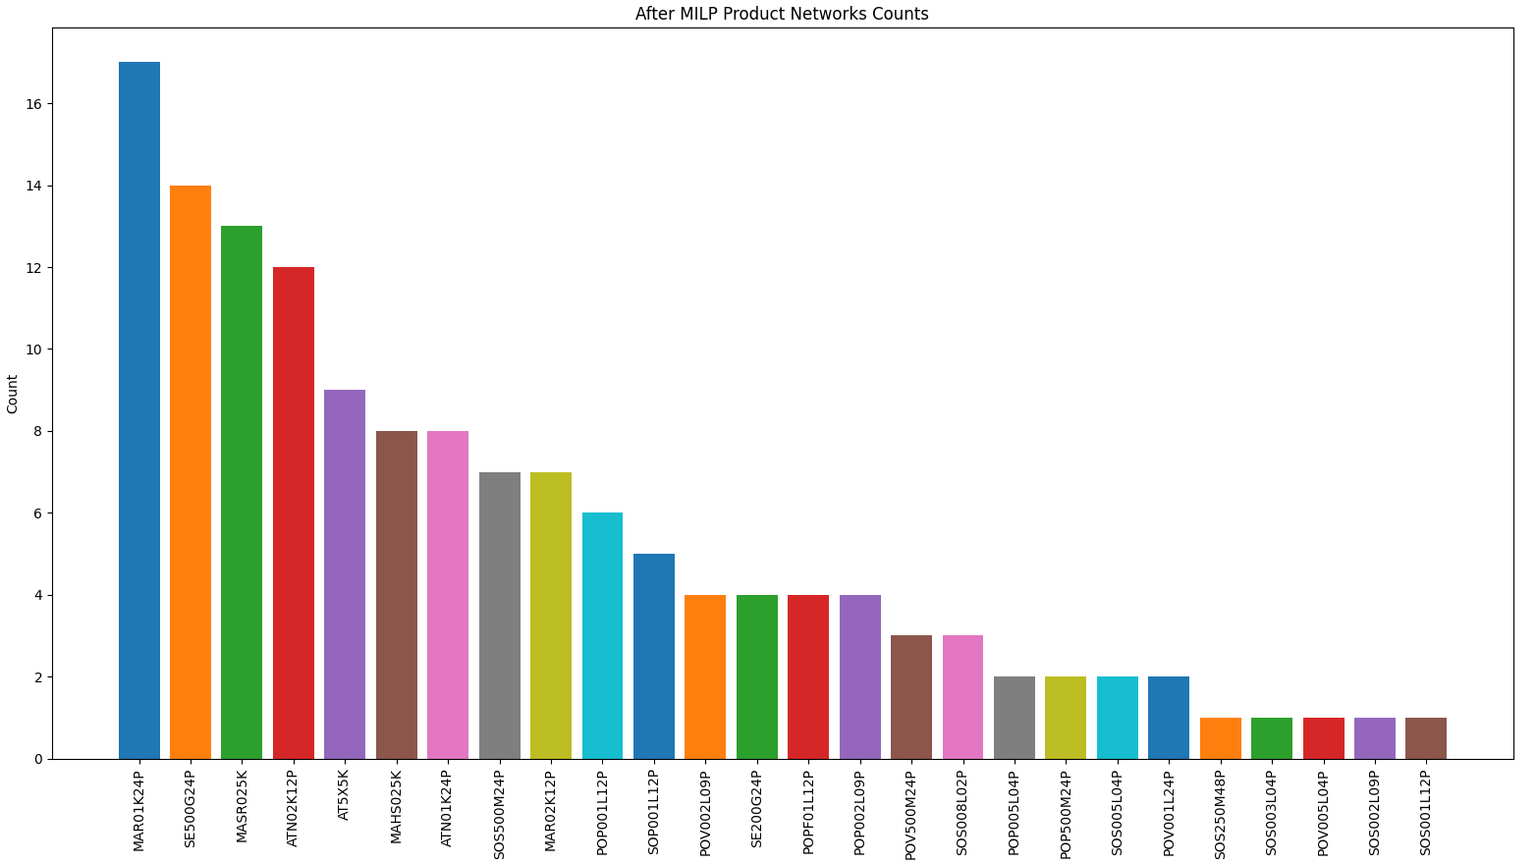
Mixed integer linear programming: Findings
Selected networks 141
26 Product networks
MAR01K24P Product network

Slide 10
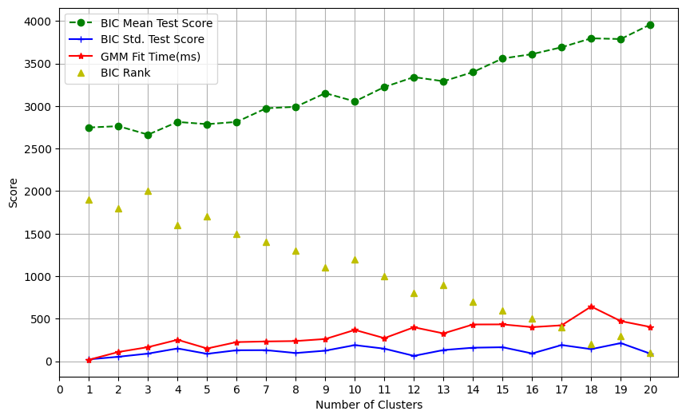
Machine Learning: Gaussian Mixture Model
‘MAR01K24P’ product network prediction model

Slide 11
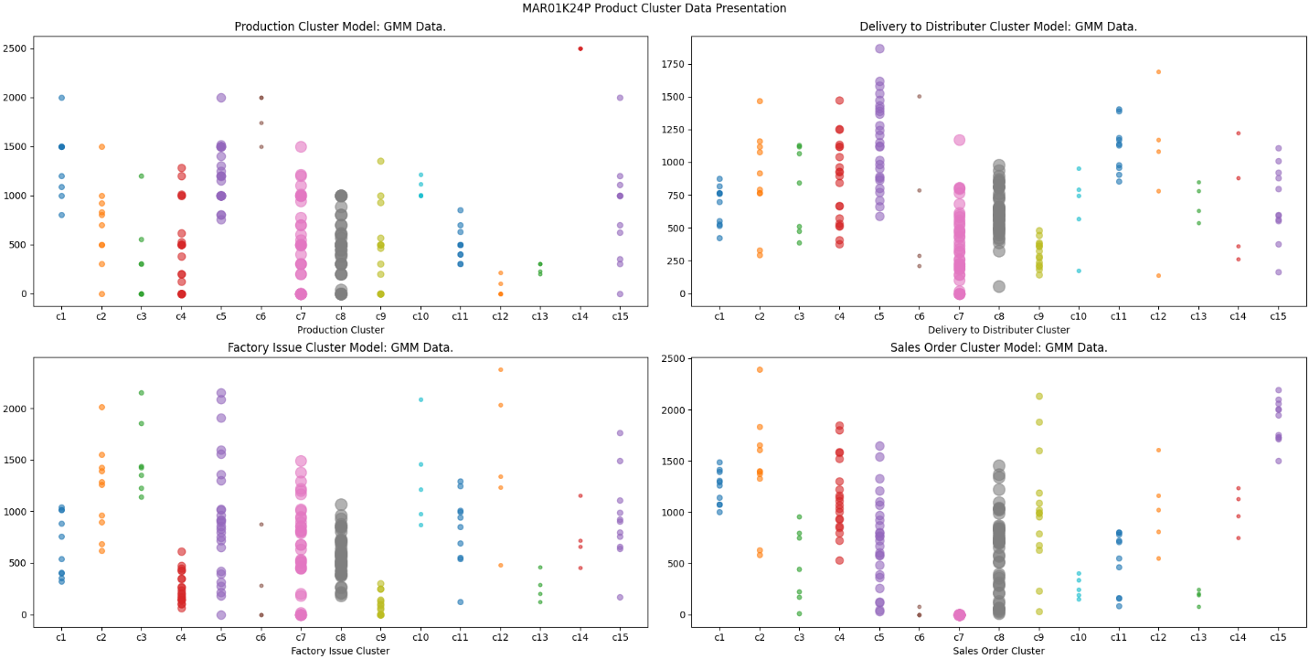
Gaussian Mixture Model: Findings
‘MAR01K24P’ product network prediction model

Slide 12
Conclusions
The research demonstrated that data driven decision taking MAR01K24P product network.
Cost effective operation selects node connection 309, edges connection 51 plants and 148 storage locations.
The c8 number cluster length is 49 which is maximum.
The network sales order range 1000 units and maximum 1000 units.
MAR01K24P is most profitable business.

Slide 13
Future Recommendation
Develop complex and more efficient Mathematical Model in DES.
Integrate more MILP constraints executing SCN co-efficient.
Requires smooth Data driven facilities for SCNs.
Applying other Machine Learning models specially Clustering.

Slide 14


Acknowledgements
Md. Aminul Islam
Associate Professor
Department of Mechanical Engineering, CUET
Honorable Teachers
Department of Mechanical Engineering,
CUET

Slide 15


